Slide 1
Data processing More statistics and some probability
Ph.D. Dang Thien Binh
IT Faculty, Da Nang University of Science and Technology

Slide 2
Table of contents
Central limit theorem, error bar, standard error of the mean, confidence interval, z-score
Correlation
PMF
CDF
PDF
Probability
Conditional probability
Hypothesis testing, p-value

Slide 3


Central limit theorem
Central limit theorem: The mean of a large number of independently and identically distributed (iid) random variables (with mean μ and standard deviation σ) is approximately normally distributed, with mean μ and standard deviation σ/sqrt(n), where n is the sample size.

Slide 4
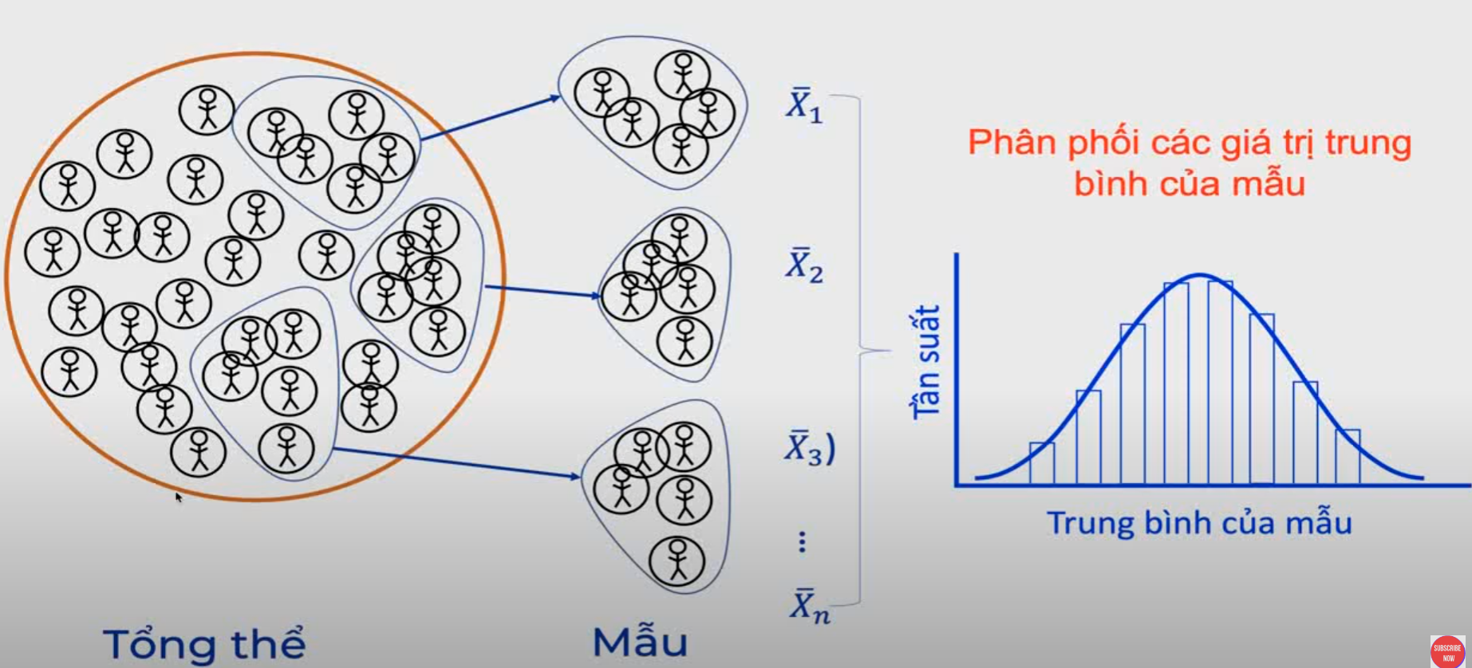
Central limit theorem

Slide 5
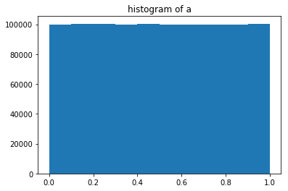
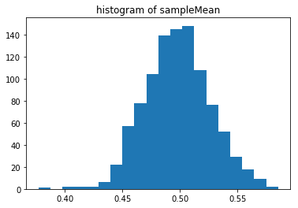
Simulation using uniform distribution
In [947]: a = rand(10**6)
...: print('population mean:', mean(a))
...: print('standard deviation:', std(a))
...: # now draw 100 samples, repeat 1000 times.
...: # save in a 100x1000 matrix
...: b = np.random.choice(a, (100,1000), replace=False)
...: # mean of each column
...: sampleMean = mean(b, axis=0)
...: hist(sampleMean, 20)
...: print('mean of sampleMean:', mean(sampleMean))
...: print('std of sampleMean:', std(sampleMean))
...:
population mean: 0.500377047392
standard deviation: 0.288753616022
mean of sampleMean: 0.500392388908
std of sampleMean: 0.0286669247346

Slide 6
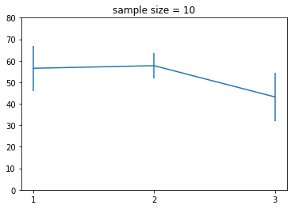
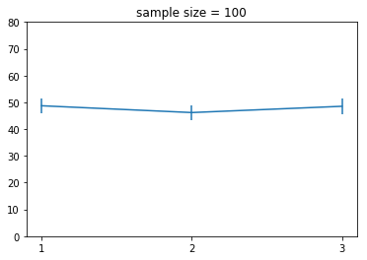
Errorbar and confidence interval
In [965]: measures = randint(0, 100, size=(10,3))
In [966]: measures
Out[966]:
array([[70, 54, 67],
[62, 24, 60],
[ 0, 61, 11],
...,
[78, 43, 94],
[45, 79, 81],
[54, 50, 29]])
In [968]: SEM = std(measures,0)/sqrt(measures.shape[0])
In [969]: errorbar([1,2,3], mean(measures,0),SEM); xticks([1,2,3])
Standard error of the mean (SEM) measures how far the sample mean (average) of the data is likely to be from the true population mean. The SEM is always smaller than the SD.

Slide 7
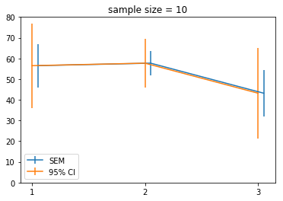
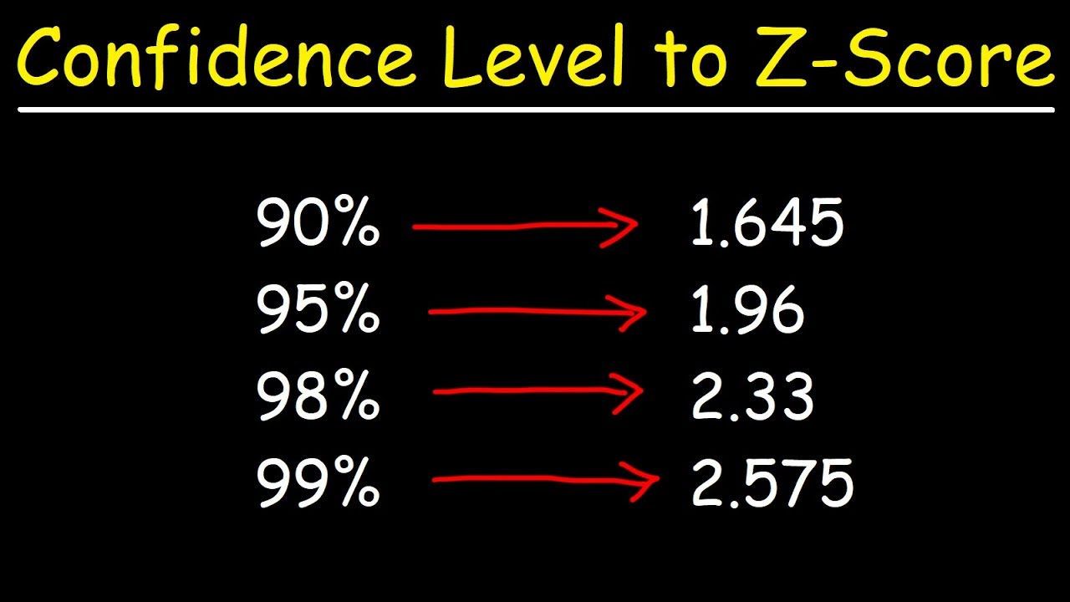
Confidence interval
Standard Error of the Mean (SEM): standard deviation / sqrt(n)
95% confidence interval: 1.96*SEM (the interval that is likely to include the real mean with 95% probability)
errorbar([1.05,2.05,3.05], mean(measures,0), SEM)
errorbar([1,2,3], mean(measures,0), SEM*1.96);

Slide 8
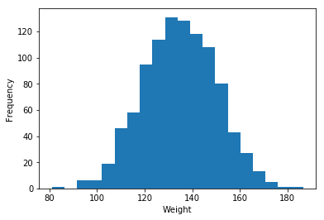
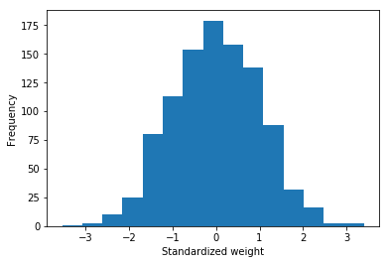
Standard score (z-score)
hist (weight)
Z_{i} = (x_{i} - μ) / σ
Z-score is unit-less, can be + or -
When distribution is approx. normal, z-score can be conveniently mapped to probabilities
hist((weight - mean(weight))/std(weight))
# weight: body weight of a certain population (in LB)
In [1024]: weight
Out[1024]: array([ 156., 140., 145., ..., 139., 140., 124.])

Slide 9
Correlation
Measures the (linear) relationship between two variables, X = [x₁, x₂, …X_{n}], and Y = [y₁, y₂, …, y_{n}]
E.g. between one’s height and weight
Between results of two tests
Problem: the two variables may be on different unit, different scale, or different distribution
Option 1: convert the measurement to standardized score (z-score)
Pearson Correlation Coefficient
Option 2: sort the values and convert the measurement to ranks
Spearman Rank Correlation Coefficient

Slide 10
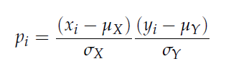

Pearson Correlation Coefficient

Slide 11
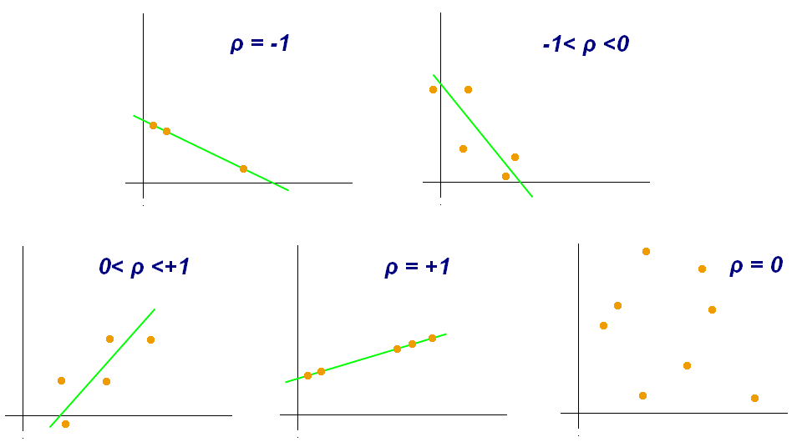
Pearson Correlation Coefficient
The Pearson correlation coefficient varies between −1 and +1 with +1 signifying a perfect positive relationship between X and Y (as X increases, Y increases)

Slide 12
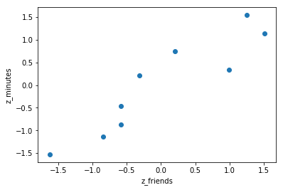
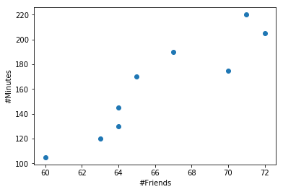
In [1076]: friends = array([ 70, 65, 72, 63, 71, 64, 60, 64, 67])
...: minutes = array([175, 170, 205, 120, 220, 130, 105, 145, 190])
...:
...: def zscore(numArray):
...: return (numArray - mean(numArray))/std(numArray)
...:
...: zfriends = zscore(friends)
...: zminutes = zscore(minutes)
...:
...: scatter(zfriends, zminutes)
...: xlabel('z_friends')
...: ylabel('z_minutes')
...:
...: zfriends.dot(zminutes) / len(friends)
...:
Out[1076]: 0.92246383021660039
# using np.corrcoef gives the same result
In [1080]: np.corrcoef(friends, minutes)
Out[1080]:
array([[ 1. , 0.92246383],
[ 0.92246383, 1. ]])

Slide 13
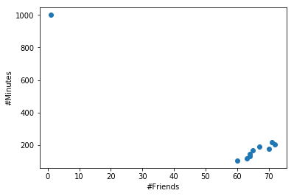
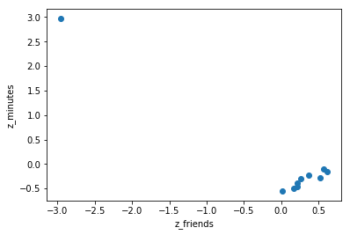
Pearson correlation coefficient is sensitive to outliers
In [1085]: friends2=np.append(friends,1)
In [1086]: minutes2=np.append(minutes,1000)
In [1091]: np.corrcoef(friends2, minutes2)[0,1]
Out[1091]: -0.95014946790238775

Slide 14
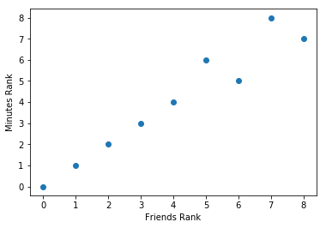
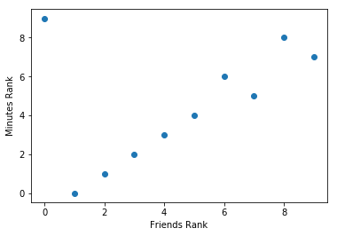

Spearman Rank Correlation Coefficient
In [1113]: friends_rank = argsort(argsort(friends))
...: minutes_rank = argsort(argsort(minutes))
...: corrcoef(friends_rank, minutes_rank)[0,1]
...:
Out[1113]: 0.96666666666666667
In [1114]: friends_rank = argsort(argsort(friends2))
...: minutes_rank = argsort(argsort(minutes2))
...: corrcoef(friends_rank, minutes_rank)[0,1]
...:
Out[1114]: 0.43030303030303024

Slide 15
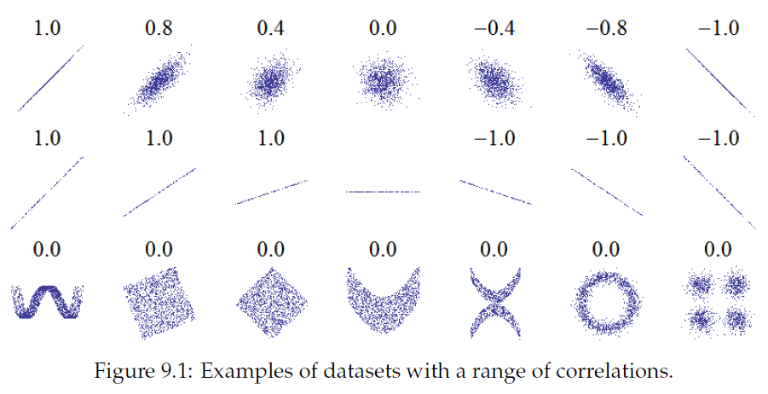
Correlation only measures linear relationship

Slide 16
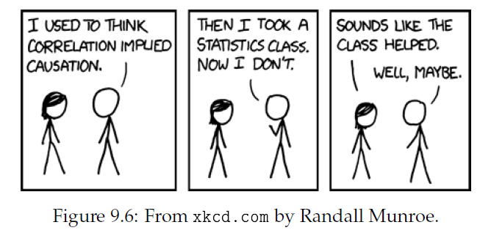
Correlation does not imply causation
In general, correlation between two variables does not tell you whether one causes the other, or the other way around or whether they might both be caused by something else altogether.
Ways to help figure out: time, randomized controlled trial, etc.

Slide 17
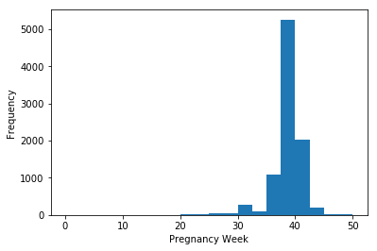
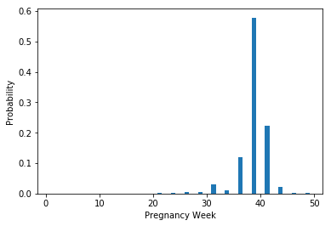
Probability Mass Function
histogram
NSFG: National Survey of Family Growth
Collected by the US Center of Disease Control and Prevention.
Downloaded from the website of ThinkStats.
Do first babies tend to come late?
# lots of preprocessing: remove NA, errors, etc.
# prglength: duration of pregnancy (in weeks)
In [1180]: counts =hist(prglength, bins=20)
...: xlabel('Pregnancy Week')
...: ylabel('Frequency')
...: show()
...: bin_center = (counts[1][1:]+counts[1][:-1])/2
...: bar(bin_center, counts[0]/sum(counts[0]))
...: xlabel('Pregnancy Week')
...: ylabel('Probability')
PMF

Slide 18
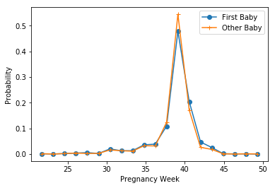
First baby vs other baby
firstbabycounts =hist(prglength[firstbaby], bins=counts[1])
show()
otherbabycounts =hist(prglength[~firstbaby], bins=counts[1])
show()
plot(bin_center, firstbabycounts[0]/sum(firstbaby), '-o', bin_center, otherbabycounts[0]/sum(~firstbaby), '-+')
xlabel('Pregnancy Week')
ylabel('Probability')
legend(('First Baby', 'Other Baby'))

Slide 19
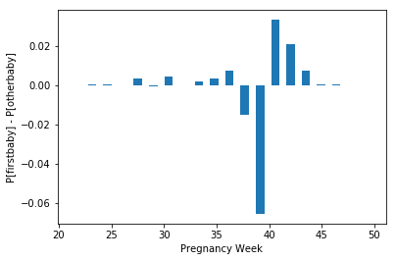
First baby vs other baby
bar(bin_center, firstbabycounts[0]/sum(firstbaby) - otherbabycounts[0]/sum(~firstbaby))
xlabel('Pregnancy Week')
ylabel('P[firstbaby] - P[otherbaby]')

Slide 20
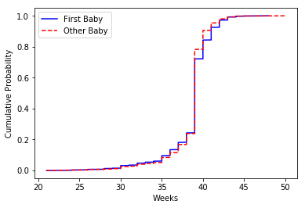
Cumulative distribution
In [1245]: plot(sort(prglength[firstbaby]), range(sum(firstbaby))/sum(firstbaby), '-b')
...: plot(sort(prglength[~firstbaby]), range(sum(~firstbaby))/sum(~firstbaby), 'r--')
...: legend(('First Baby', 'Other Baby'))
...: xlabel('Weeks')
...: ylabel('Cumulative Probability')
...: show()

Slide 21
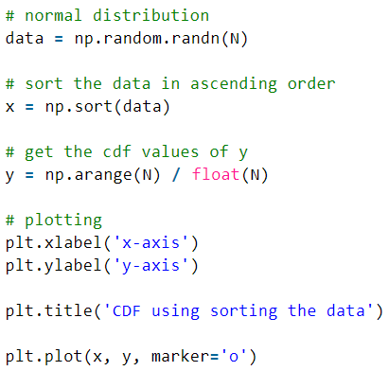
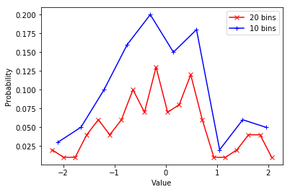
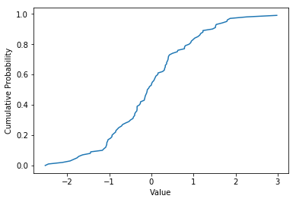
PMF vs CDF
PMF vs CDF for a random array of 100 normally distributed numbers
plot(bin_center20, counts20[0]/sum(counts20[0]), 'r-x',
bin_center10, counts10[0]/sum(counts10[0]), 'b-+')
plot(sort(a), arange(len(a))/len(a))

Slide 22
PDF and continuous distribution
For continuous distribution, no PMF.
Instead, probability density function is available.
PDF is the derivative of CDF
Integral of PDF = 1.0

Slide 23
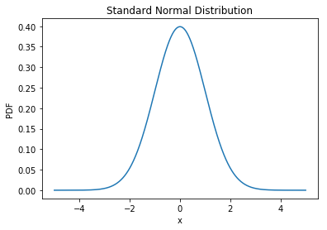
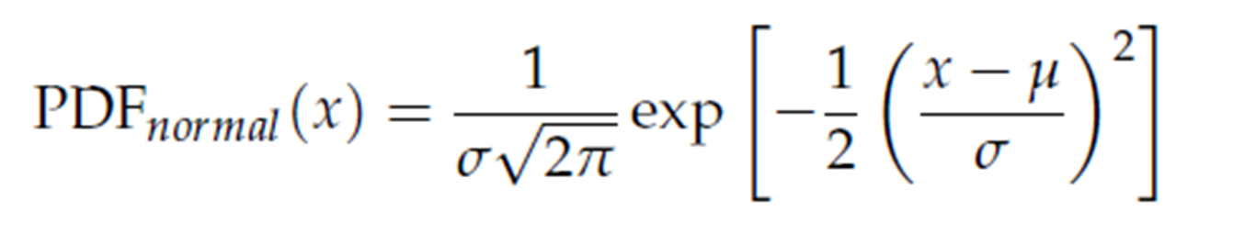
Standard normal pdf
In [1331]: x = linspace(-5,5,10**3)
In [1332]: y = normpdf(x, 0, 1)
In [1335]: plot(x, y); xlabel('x'); ylabel('PDF'); title('Standard Normal Distribution')
In [1337]: normpdf(0, 0, 1)
Out[1337]: 0.3989422804014327
What does this mean?

Slide 24

Standard normal distribution

Slide 25
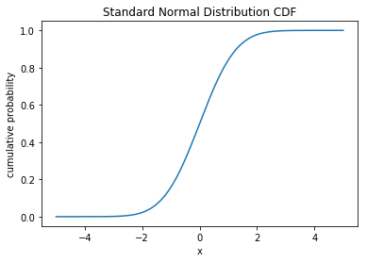
Standard normal distribution CDF
In [1351]: plot(x, norm.cdf(x)); xlabel('x'); ylabel('cumulative probability'); title('Standard Normal Distribution CDF')
In [1353]: norm.cdf(0.5)-norm.cdf(-0.5)
Out[1353]: 0.38292492254802624
In [1356]: 2*(0.5-norm.cdf(-0.5))
Out[1356]: 0.38292492254802624
In [1357]: 2*(norm.cdf(0)-norm.cdf(-0.5))
Out[1357]: 0.38292492254802624

Slide 26
Standard normal distribution CDF
In [1353]: norm.cdf(1.96) - norm.cdf(-1.96)
Out[1353]: 0.95000420970355903
In [1380]: 1-2*norm.cdf(-1.96)
Out[1380]: 0.95000420970355914
“95% confidence interval”

Slide 27
Properties of normal distribution
If the distribution of a random variable X is normal with mean μ and standard deviation σ, we usually write: X ∼ N(μ, σ²)
A linear transformation of X results in X’ = aX + b, then
X’ ∼ N(aμ+b, a ² σ²)
If X ∼ N(μ_{X}, σ_{X}²) and Y ∼ N(μ_{Y}, σ_{Y}²), then
Z = X + Y ∼ N(μ_{X} + μ_{Y}, σ_{X}² + σ_{Y}²)
If X ∼ N(μ, σ²),
Then Z = (X- μ)/ σ ∼ N(0, 1)
This is called Z-transformation or standardization. The transformed value is often called Z-score or standard score.

Slide 28
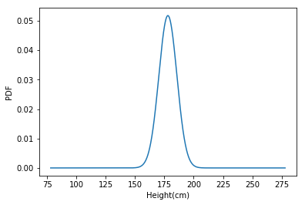
Normal distribution
The US National Center for Chronic Disease Prevention and Health Promotion surveyed >400,000 individuals for health-related info (BRFSS – Behavioral Risk Factor Surveillance System)
http://thinkstats. com/brfss.py
The distribution is roughly normal with parameter μ = 178cm and σ²=59.4cm²
σ=sqrt(59.4) = 7.707cm
What percentage of US male population is between 177.8cm and 185.4cm?
N(178, 59.4)

Slide 29
Normal distribution – cont’d
Height distribution is in X ∼ N(178, 59.4)
P(177.8 ≤ X ≤ 185.4) = ?
X’ = (X – 178) / 7.707 ∼ N(0, 1)
(185.4 – 178) / 7.707 = 0.96
(177.8-178)/7.707 = -0.03
In [1374]: norm.cdf(185.4,178,7.707)-norm.cdf(177.8, 178, 7.707)
Out[1374]: 0.34186118517420605
In [1375]: norm.cdf(0.96) - norm.cdf(-0.03)
Out[1375]: 0.34343886594727485

Slide 30
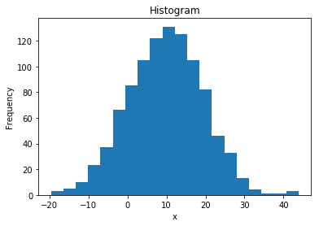
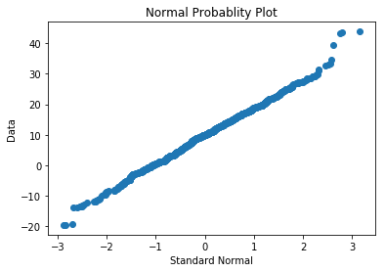
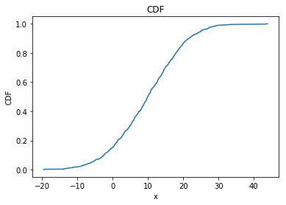

Normal probability plot
x = 10*numpy.random.randn(1000)+10

Slide 31
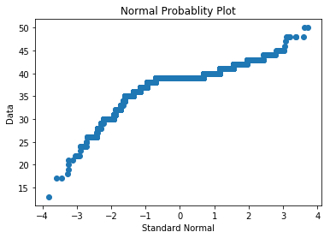
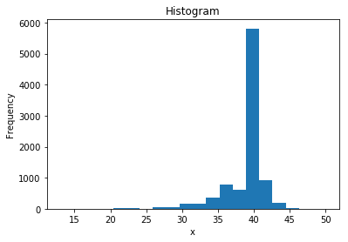
Probability distribution of pregnancy length

Slide 32
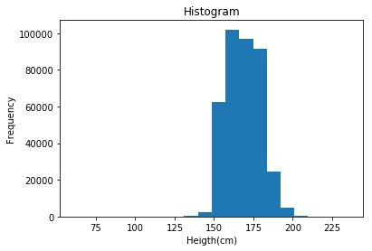
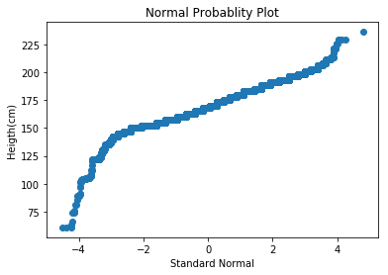
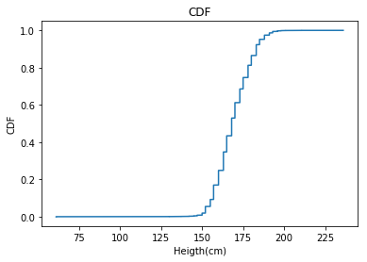
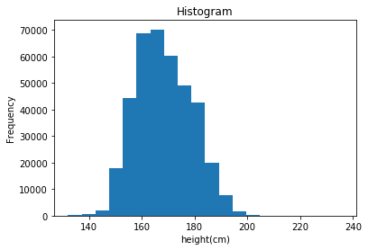
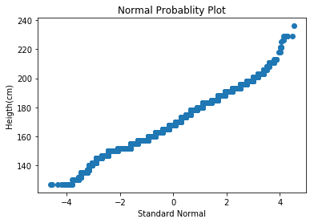
Probability distribution for BRFSS height data
Discarded height < 130

Slide 33
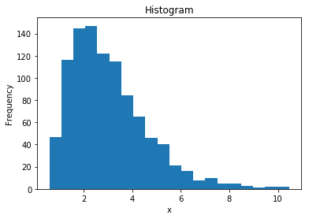
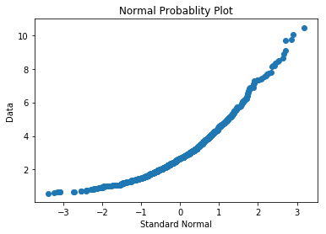
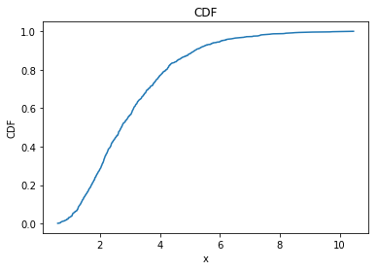
Normal probability plot for right skewed data
x = numpy.random.lognormal(mean=1, sigma=0.5, size=1000)

Slide 34
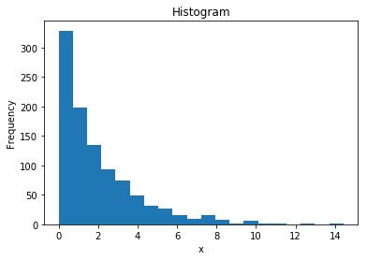
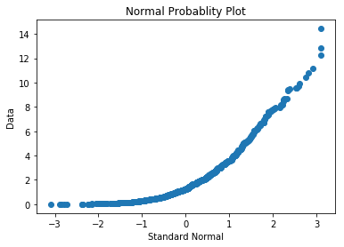
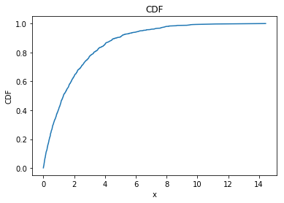
Normal probability plot for another right skewed data
x = numpy.random.exponential(scale=10,size=1000)

Slide 35
Why model
Data compression – a small set of parameters may be sufficient to summarize a large data set
Sometimes can smooth out noises
When data from a natural phenomenon fit a distribution, it can lead to insight into the physical system which can explain why the observed data has a particular form
Other commonly seen distributions:
Lognormal
Exponential
Pareto

Slide 36
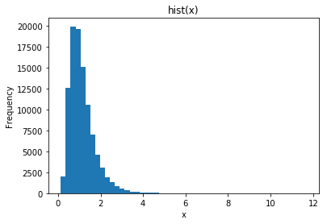
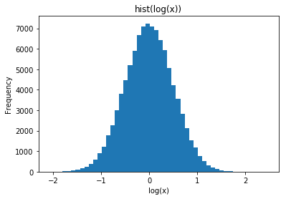
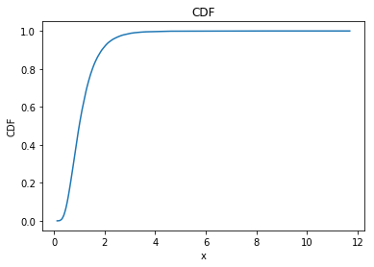
Log normal distribution
Log(x) is normally distributed.
In [1431]: x=lognormal(0, 0.5, 10**5);
In [1432]: hist(x, 50)

Slide 37


Probability distribution for BRFSS weight data

Slide 38


Probability distribution for BRFSS weight data after log transformation
In [376]: corrcoef(weight, height)[0][1]
Out[376]: 0.5110289460952534
In [377]: corrcoef(log(weight), height)[0][1]
Out[377]: 0.53405888354314057

Slide 39


Correlation between height and weight
In [376]: corrcoef(weight, height)[0][1]
Out[376]: 0.5110289460952534
In [377]: corrcoef(log(weight), height)[0][1]
Out[377]: 0.53405888354314057

Slide 40


Log normal distribution with different parameters
https://en.wikipedia.org/wiki/Log-normal_distribution

Slide 41


Exponential distribution
PDF: λ e^{−λx}
CDF: 1 − e^{−λx}
the time between events in a Poisson process,

Slide 42



Exponential distribution - 2
Often used to measure time between events – interarrival times.
arrivalTime = unique( (rand(1000) * 10**5).round());
x = diff(arrivalTime);

Slide 43


Exponential distribution CCDF
CCDF (complementary cumulative distribution) = 1 – CDF = e^{−λx}

Slide 44




Pareto distribution
PDF:
CDF:

Slide 45





Simulated data in Pareto distribution
CCDF = 1 – CDF =
d=[random.paretovariate(2.5) for i in range(10**5)]

Slide 46
Pareto distribution - 2
Occur in nature
E.g. size of cities. Distribution of wealth
Related to power-law function and scale-freeness
Data: population of every incorporated city and town in the US
In [446]: len(pops)
Out[446]: 14593
In [447]: max(pops)
Out[447]: 8008654
In [448]: min(pops)
Out[448]: 1
In [449]: median(pops)
Out[449]: 1276.0
In [450]: mean(pops)
Out[450]: 11116.203316658672
http://thinkstats.com/populations.py

Slide 47



Distribution of populations in US cities

Slide 48


Distribution of populations in US cities - 2
Lognormal actually fits better

Slide 49
Why model
Data compression – a small set of parameters may be sufficient to summarize a large data set
Sometimes can smooth out noises
When data from a natural phenomenon fit a distribution, it can lead to insight into the physical system which can explain why the observed data has a particular form
Many machine learning methods assume certain data distribution. It is important to investigate the actual data distribution.
It is often difficult to fit an exact model.
Make reasonable approximations
Try different transformation and cleaning

Slide 50
Probability Rules
Definition (informal)
Experiment: e.g. toss a coin 10 times or roll a dice 10 times
Outcome: A possible result of an experiment. e.g. HHHTTTHTTH or 1363254325
The sample space S of a random experiment is the set of all possible outcomes. e.g {H, T}¹⁰
Event: any subset of the sample space. E.g.: > 4 heads
Probabilities are numbers assigned to events that indicate “how likely” it is that the event will occur when a random experiment is performed
A probability law for a random experiment is a rule that assigns probabilities to the events in the experiment

Slide 51
Example
0 ≤ P(A_{i}) ≤ 1
P(S) = 1

Slide 52

Probabilistic Calculus
P(A U B) = P(A) + P(B) – P(A ∩ B)
If A, B are mutually exclusive:
P(A ∩ B) = 0
P(A U B) = P(A) + P(B)
A and not(A) are mutually exclusive
Thus: P(not(A)) = P(A^{c}) = 1 – P(A)
Either A or B
both A and B
s
A
B

Slide 53
Joint and conditional probability
The joint probability of two events A and B P(A∩B), or simply P(A, B) is the probability that event A and B occur at the same time.
The conditional probability of P(A|B) is the probability that A occurs given B occurred.
P(A | B) = P(A ∩ B) / P(B)
P(A ∩ B) = P(A | B) * P(B)

Slide 54
Example
Roll a dice
If I tell you the number is less than 4
What is the prob for the number to be even?
P(d = even | d < 4)
= P(d = even ∩ d < 4) / P(d < 4)
= P(d = 2) / P(d = 1, 2, or 3)
= (1/6) / (3/6) = 1/3

Slide 55
Independence
P(A | B) = P(A ∩ B) / P(B)
=> P(A ∩ B) = P(B) * P(A | B)
A, B are independent iff
P(A ∩ B) = P(A) * P(B)
That is, P(A) = P(A | B)
Also implies that P(B) = P(B | A)
P(A ∩ B) = P(B) * P(A | B) = P(A) * P(B | A)

Slide 56
Examples
Are P(d = even) and P(d < 4) independent?
P(d = even and d < 4) = 1/6
≠ P(d = even) * P(d < 4) = 1/4
or
P(d = even) = ½
≠ P(d = even | d < 4) = 1/3
If the dice has 8 faces, will P(d = even) and P(d < 5) be independent?

Slide 57
Theorem of total probability
Let B₁, B₂, …, B_{N} be mutually exclusive events whose union equals the sample space S. We refer to these sets as a partition of S.
An event A can be represented as:
Since B₁, B₂, …, B_{N} are mutually exclusive, then
P(A) = P(A∩B₁) + P(A∩B₂) + … + P(A∩B_{N})
And therefore
P(A) = P(A|B₁)*P(B₁) + P(A|B₂)*P(B₂) + … + P(A|B_{N})*P(B_{N})
= Σ_{i} P(A | B_{i}) * P(B_{i})

Slide 58
Example
A loaded dice:
P(6) = 0.5
P(1) = … = P(5) = 0.1
Prob of even number?
P(even)
= P(even | d < 6) * P (d<6) +
P(even | d = 6) * P (d=6)
= 2/5 * 0.5 + 1 * 0.5
= 0.7

Slide 59
Another example
A box of dice:
99% fair
1% loaded
P(6) = 0.5.
P(1) = … = P(5) = 0.1
Randomly pick a die and roll, P(6)?
P(6) = P(6 | F) * P(F) + P(6 | L) * P(L)
1/6 * 0.99 + 0.5 * 0.01 = 0.17

Slide 60
Chain rule
P(x1, x2, x3) = P(x1, x2, x3) / P(x2, x3)
* P(x2, x3) / P(x3)
* P(x3)
= P(x1 | x2, x3) P(x2 | x3) P(x3)
x3
x2
x1

Slide 61
Bayes theorem
P(A ∩ B) = P(B) * P(A | B) = P(A) * P(B | A)
Conditional probability
(likelihood)
P
(
A
|
B
)
P
(
B
)
Prior of B
=>
P
(
B
|
A
)
=
P
(
A
)
Posterior probability
Prior of A (Normalizing constant)
This is known as Bayes Theorem or Bayes Rule, and is (one of) the most useful relations in probability and statistics
Bayes Theorem is definitely the fundamental relation in Statistical Pattern Recognition

Slide 62
Bayes theorem (cont’d)
Given B₁, B₂, …, B_{N}, a partition of the sample space S. Suppose that event A occurs; what is the probability of event B_{j}?
P(B_{j} | A) = P(A | B_{j}) * P(B_{j}) / P(A)
= P(A | B_{j}) * P(B_{j}) / Σ_{j}P(A | B_{j})*P(B_{j})
Posterior probability
Likelihood
Prior of B_{j}
Normalizing constant
(theorem of total probability)
B_{j}: different models
In the observation of A, should you choose a model that maximizes P(B_{j} | A) or P(A | B_{j})? Depending on how much you know about B_{j} !

Slide 63
Example
Prosecutor’s fallacy
Some crime happened
The criminal left not evidence except hair
The police got his DNA from his hair
Expert matched the DNA with someone’s DNA in a database
Expert said both false-positive and false negative rates are 10⁻⁶
Can this be used as an evidence of guilty against the suspect?

Slide 64
Prosecutor’s fallacy
False Pos: P(match | innocent) = 10⁻⁶
False Neg: P(no match | guilty) = 10⁻⁶
P(match | guilty) = 1 - 10⁻⁶ ~ 1
P(no match | innocent) = 1 - 10⁻⁶ ~ 1
P(guilty | match) = ?

Slide 65
Prosecutor’s fallacy
P (g | m) = P (m | g) * P(g) / P (m)
~ P(g) / P(m)
P(g): the prior probability for someone to be guilty with no DNA evidence
P(m): the probability for a DNA match
How to get these two numbers?
Don’t really care P(m)
Want to compare two models:
P(g | m) and P(i | m)

Slide 66
Prosecutor’s fallacy
P(i | m) = P(m | i) * P(i) / P(m)
P(g | m) = P(m | g) * P(g) / P(m)
Therefore
P(i | m) / P(g | m) = P(m | i) / P(m | g) * P(i) / P(g)
= 10⁻⁶ * P(i) / P(g)
P(i) + P(g) = 1
It is clear, therefore, that whether we can conclude the suspect is guilty depends on the prior probability P(g)

Slide 67
Prosecutor’s fallacy
How do you get P(g)?
Depending on what other information you have on the suspect
Say if the suspect has no other connection with the crime, and the overall crime rate is 10⁻⁷
That’s a reasonable prior for P(g)
P(g) = 10⁻⁷, P(i) ~ 1
P(i | m) / P(g | m) = 10⁻⁶ * P(i) / P(g) = 10⁻⁶/10⁻⁷ = 10
Or: P(i | m) = 0.91 and P(g | m) = 0.09
Suspect is more likely to be innocent than guilty, given only the DNA samples

Slide 68
another example
We’ve talked about the boxes of dices: 99% fair, 1% loaded (50% at six)
We said if we randomly pick a die and roll, we have 17% of chance to get a six
If we get 3 six in a row, what’s the chance that the die is loaded?
How about 5 six in a row?

Slide 69
P(loaded | 666)
= P(666 | loaded) * P(loaded) / P(666)
= 0.5³ * 0.01 / (0.5³ * 0.01 + (1/6)³ * 0.99)
= 0.21
P(loaded | 66666)
= P(66666 | loaded) * P(loaded) / P(66666)
= 0.5⁵ * 0.01 / (0.5⁵ * 0.01 + (1/6)⁵ * 0.99)
= 0.71

Slide 70
Binomial distribution
Roll a die, the chance of getting 6 is 1/6
Roll 100 dice, the chance of getting all sixes is (1/6)¹⁰⁰
The chance of getting no sixes at all is (5/6)¹⁰⁰
What is the chance of getting exactly 20 sixes?
Simpler case: roll 4 dice, what is the chance of getting exactly 2 sixes?
66xx, 6x6x, 6xx6, x66x, x6x6, xx66 (x stands for 1-5)
Each of the above event has probability (1/6)²(5/6)²
Number of events above: choose 2 combination from 4: 4!/(2!2!)
P = 4!/(2!2!) * (1/6)²(5/6)²
Probability of exactly 20 sixes out of 100 rolls?
Possible positions for 20 sixes: choose 20 combination from 100: 100!/(20!80!)
Each combination has probability (1/6)²⁰(5/6)⁸⁰
P = 100!/(20!80!) * (1/6)²⁰(5/6)⁸⁰

Slide 71



Binomial distribution PMF
$BinomPMF(n,k,p)=\left({n \atop k}\right)p^{k}{ (1−p)}^{n−k}$
Mean: np
Variance: np(1-p)
Flip a coin 10 times, what is the probability of seeing exactly 5 heads?
In [79]: from math import factorial
...: def nchoosek(n, k):
...: return factorial(n) / factorial(k) / factorial(n-k)
...: def binomPMF(k, n, p):
...: return nchoosek(n, k) * p**k * (1-p)**(n-k)
...:
...: binomPMF(10, 5, 0.5)
...:
Out[79]: 0.24609375

Slide 72

Binomial distribution
Flip a coin 10 times, what is the probability of seeing at least 5 heads?
In [84]: sum([binomPMF(i, 10, 0.5) for i in range(5,11)])
Out[84]: 0.623046875

Slide 73
Statistical hypothesis testing
I give you a coin, which could be a “fair” coin or could be “loaded”
If you flip it, a fair coin gives head and tail with equal probability
In contrast, a loaded coin tends to give one side more frequently than the other
Give you a coin, how do you know the coin is likely fair or loaded?
Classical setup
H0 (null hypothesis): the coin is fair
H1 (alternative hypothesis): the coin is loaded (i.e., biased towards head or tail)
Usually it is hard to argue how loaded it could be
Based on experimental results, can we determine that H0 is unlikely true and therefore reject it?

Slide 74
Fair or not fair?
If you flip the coin 10 times, and observed 9 heads, how likely this is a fair coin?
P-value: if the null hypothesis is true (coin is fair), how likely you can observe a result that is as unfair as the observed result?
P(at least 9 heads or 9 tails | coin is fair) = 2*(binomPMF(9, 10, 0.5) + binomPMF(10, 10, 0.5))
Two-sided test
In [108]: 2*sum([binomPMF(i, 10, 0.5) for i in range(9,11)])
Out[108]: 0.021484375
Significance, or p-value represents the probability that we will make a type I error (false positive) – we reject H0 even though it is true.
Typical level of acceptable type I error is 0.05 or 0.01.

Slide 75


Fair or not fair?

Slide 76
One-sided vs two-sided test
H0: the coin is not biased toward head, i.e., p(head) <= 0.5
H1: the coin is biased toward head, i.e. p(head) > 0.5.
Flip a coin 10 times, observed 9 heads
P(at least 9 heads | H0) <= P(at least 9 heads | coin is fair) = 0.01
One-sided test
Two-sided and one-sided test need to be decided before the actual test.
Two-sided test is more common, as we are often interested in both positive and negative effects.

Slide 77

One-sided vs two-sided test

Slide 78
T-test – do first babies tend to be born late?
Used to test if the means from two groups are significantly different from each other
Do first babies tend to be born late?

Slide 79

Do first baby tend to be born late?
import numpy as np
import matplotlib.pyplot as plt
import scipy.stats as stat
import survey
preg = survey.Pregnancies()
preg.ReadRecords('.')
data = [(r.prglength, r.birthord, r.outcome) for r in preg.records]
# filtering
data = [r for r in data if 'NA' not in r and r[2] == 1 and r[0] > 10] data = np.array(data)
firstbaby = data[:, 1] == 1
prglen = data[:,0]
stat.ttest_ind(prglen[firstbaby], prglen[~firstbaby])
firstmean = prglen[firstbaby].mean() #38.61
othermean = prglen[~firstbaby].mean() #38.54
firstsem = prglen[firstbaby].std()/sqrt(sum(firstbaby)) #0.04
othersem = prglen[~firstbaby].std()/sqrt(sum(~firstbaby)) #0.04
plt.errorbar(range(2), [firstmean, othermean], [firstsem, othersem]);

Slide 80


Unpaired t-test
Assuming two groups have the same variance
In [178]: scipy.stats.ttest_ind(prglen[firstbaby], prglen[~firstbaby])
Out[178]: Ttest_indResult(statistic=1.3311151692428498, pvalue=0.18318430868373525)
In [184]: stat.ttest_ind(prglen[firstbaby], prglen[~firstbaby], equal_var = False)
Out[184]: Ttest_indResult(statistic=1.327584272139001, pvalue=0.18434933181897026)
No significant difference. Data does not support the hypothesis
that first babies tend to be born late.

Slide 81


Paired t-test
Used when the two samples are not independent.
E.g. measurement for a group of individuals pre- and post-treatment
Or measurements are for matched pairs

Slide 82
Paired t-test - 2
Do students get better grades after treatment?
In [228]: grades.tolist()
Out[228]:
[[ 104., 107.],
[ 81., 82.],
[ 46., 48.],
[ 81., 84.],
[ 80., 80.],
[ 91., 91.],
[ 57., 59.],
[ 72., 74.],
[ 78., 77.],
[ 90., 90.]]
In [234]: grades.mean(0) # Mean
Out[234]: array([ 78. , 79.2])
In [235]: grades.std(0)/sqrt(10) # SEM
Out[235]: array([ 5.01198563, 4.97352993])
In [236]: stat.ttest_ind(grades[:,1], grades[:,0])
Out[236]: Ttest_indResult(statistic=0.161, pvalue=0.873)
No significant difference
In [237]: (grades[:,1]-grades[:,0]).mean() # mean difference
Out[238]: 1.2
In [238]: (grades[:,1]-grades[:,0]).std()/sqrt(10) # SEM of difference
Out[237]: 0.41952353926806063

Slide 83

Paired t-test - 3
In [228]: grades.tolist()
Out[228]:
[[ 104., 107.],
[ 81., 82.],
[ 46., 48.],
[ 81., 84.],
[ 80., 80.],
[ 91., 91.],
[ 57., 59.],
[ 72., 74.],
[ 78., 77.],
[ 90., 90.]]
Mean of the differences
Standard deviation of the differences
μ₀ is usually 0, unless the goal is to test whether the difference is significant different from μ₀
In [232]: stat.ttest_1samp(grades[:,1]-grades[:,0], 0)
Out[232]: Ttest_1sampResult(statistic=2.713, pvalue=0.0238)
Significant improvement

Slide 84
P-hacking T-test – do first babies tend to born late?
Pregnancy with complications
In [178]: scipy.stats.ttest_ind(prglen[firstbaby], prglen[~firstbaby])
Out[178]: Ttest_indResult(statistic=1.3311151692428498, pvalue=0.18318430868373525)
Not significant
In [651]: stat.ttest_ind(prglen[firstbaby & (prglen > 30)], prglen[~firstbaby & (prglen > 30)])
Out[651]: Ttest_indResult(statistic=3.078170025144257, pvalue=0.0020891091939566528)
Significant
In [657]: stat.ttest_ind(prglen[firstbaby & (prglen > 35)], prglen[~firstbaby & (prglen > 35)])
Out[657]: Ttest_indResult(statistic=5.6315002087711932, pvalue=1.8446221993959388e-08)
More significant
Is it okay to find a range to maximize significance (minimize p-value)?

Slide 85
Multiple testing problem
Give you a coin, without knowing fair or loaded, you can toss it for 10 times, and use the result to reasonably argue whether it is loaded
E.g. if you see 10 heads in a row, you can confidently reject H0 (coin is fair).
Because P(10H | fair coin) = 0.5**10 = 0.001
Give you a box of 10**4 coins, without knowing if any of them might be loaded, you toss each one 10 times and observed some with 10 heads, some with 9 heads and so on
Can you say with confidence that those coins with 10 heads in a row are loaded?

Slide 86

Multiple testing problem - 2
If a coin is fair, toss it 10 times and observe 10 heads.
P(10H | fair coin) = 0.5**10 = 0.001
If all coins in the box of 10**4 coins are fair coins, toss each one 10 times, how many coins might give you 10 heads in a row?
Each fair coin has 0.001 chance to be tested positive (10 heads in a row)
The number of coins to be tested positive is also a binomial distribution with n = 10**4 and p = 0.001
Expectation is np = 10
Conclusion:
The individual p-value does not support whether a selected coin in the box is loaded - more stringent p-values (or corrections of p-values) are needed.
If you toss each coin 10 times, you will not have sufficient statistical power to detect loaded coins from a box of 10**4 coins, even if some are loaded - more experiments are needed.
Do first babies tend to be born late?
By applying t-test to many different ranges of values in order to minimize p-value, are we throwing a potentially good (loaded) coin into a box of random coins?
binomCDF(n=10**4, p=0.001)

Slide 87
Statistical power
Also called statistical sensitivity
1 – P(fails to reject H0 | H0 is false)
1 - false negative rate
Type II error: fails to reject H0 when H0 is false
Affected by the size of the effect and the sample size
The bigger the effect, the easier to detect with smaller sample size
The bigger the sample size, the easier to detect small effect (high sensitivity)
To calculate power, need to assume effect size. E.g., to test a coin that is loaded with p(head) = 0.9, what is the power of 10 flips at type I error rate 0.05 (to reject H0 at p = 0.05 requires at least 8 heads out of 10 flip).
Power = 1 – P(less than 8 heads | p(head=0.9)) = 0.93
In [108]: sum([binomPMF(i, 10, 0.5) for i in range(8,11)])
Out[108]: 0.0546875

Slide 88
Statistical power - 2
If a coin is loaded only with p(head) = 0.7 (small effect), what is the power of 10 flips with type I error rate = 0.05 (8 out of 10 heads).
1 – P(less than 8 out of 10 heads | pHead=0.7) = 0.38
If p(head) = 0.7, what is the power of 100 flips at pvalue=0.05 (to reject H0 at p=0.05 requires 59 heads out of 100 flips).
In [121]: 1-sum([binomPMF(i, 10, 0.7) for i in range(8)])
Out[121]: 0.38278278639999996 #power
In [135]: sum([binomPMF(100, i, 0.5) for i in range(59,101)])
Out[135]: 0.044313040057033785
In [136]: 1-sum([binomPMF(100, i, 0.7) for i in range(59)])
Out[136]: 0.9928264374006265 #power

Slide 89

Bayes inference
How to interpret p-value?
P(at least 9 heads | fair) = 0.01
Does this mean P(fair | at least 9 heads) = 0.01?
We may have some initial belief (prior), e.g. it is equally likely to be fair or loaded
How strong is your belief?
How loaded can it be?
Expressed as a distribution
We can flip the coin for some number of times (experiment), then based on the results, we revise our initial belief
Again, as a distribution
DSS Ch7, page 88-91

Slide 90
Useful python packages / modules
Module random in standard python lib
Seed()
Shuffle(), sample(), choice()
Uniform distribution: random(), randrange(), randint(),
Generate random numbers from other popular distributions:
Exponential distribution: expovariate()
Normal distribution: normalvariate(), gauss()
Log normal distribution: lognormvariate()
Pareto distribution: paretovariate()
https://docs.python.org/3/library/random.html

Slide 91
Useful python packages / modules - 2
numpy.random
Uniform distribution:
rand(d0, d1, …) generates array of random numbers
randint(low, high, shape)
Normal distribution: randn(d0, d1, …)
binomial(n, p, size)
lognormal(mean, sigma, size)
…
numpy.corrcoef()
https://docs.scipy.org/doc/numpy-1.13.0/reference/routines.random.html

Slide 92

Useful python packages / modules - 3
scipy.stats
scipy.stats.norm
scipy.stats.binom
scipy.stats.expon
scipy.stats.ttest_1samp
scipy.stats.ttest_ind
>>> norm.cdf([-1., 0, 1])
array([ 0.15865525, 0.5, 0.84134475])
>>> import numpy as np
>>> norm.cdf(np.array([-1., 0, 1]))
array([ 0.15865525, 0.5, 0.84134475])
https://docs.scipy.org/doc/scipy/reference/tutorial/stats.html

